Slide 1
BINF 4002
Lecture 1

Slide 2
Today’s Class
Introductions!
Course Logistics
Goals
~ Syllabus / Assignments / Exams
Activity

Slide 3
Course Logistics
Lectures Tue/Thu, 9-10:15
Recitations Mondays 9-10am (starting next week)
There will be 3 assignments, a Paper / Paper Discussion, and a Final Exam
Platforms:
Courseworks
Ed / Slack / canvas / harmonize / piazza (poll?)

Slide 4
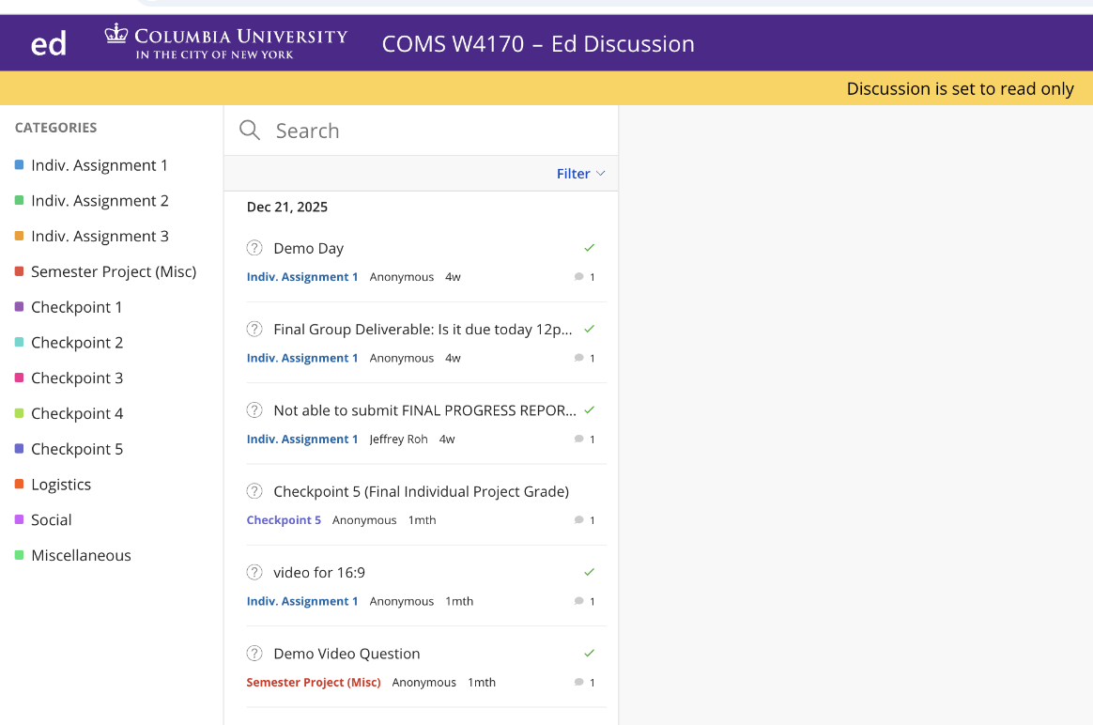
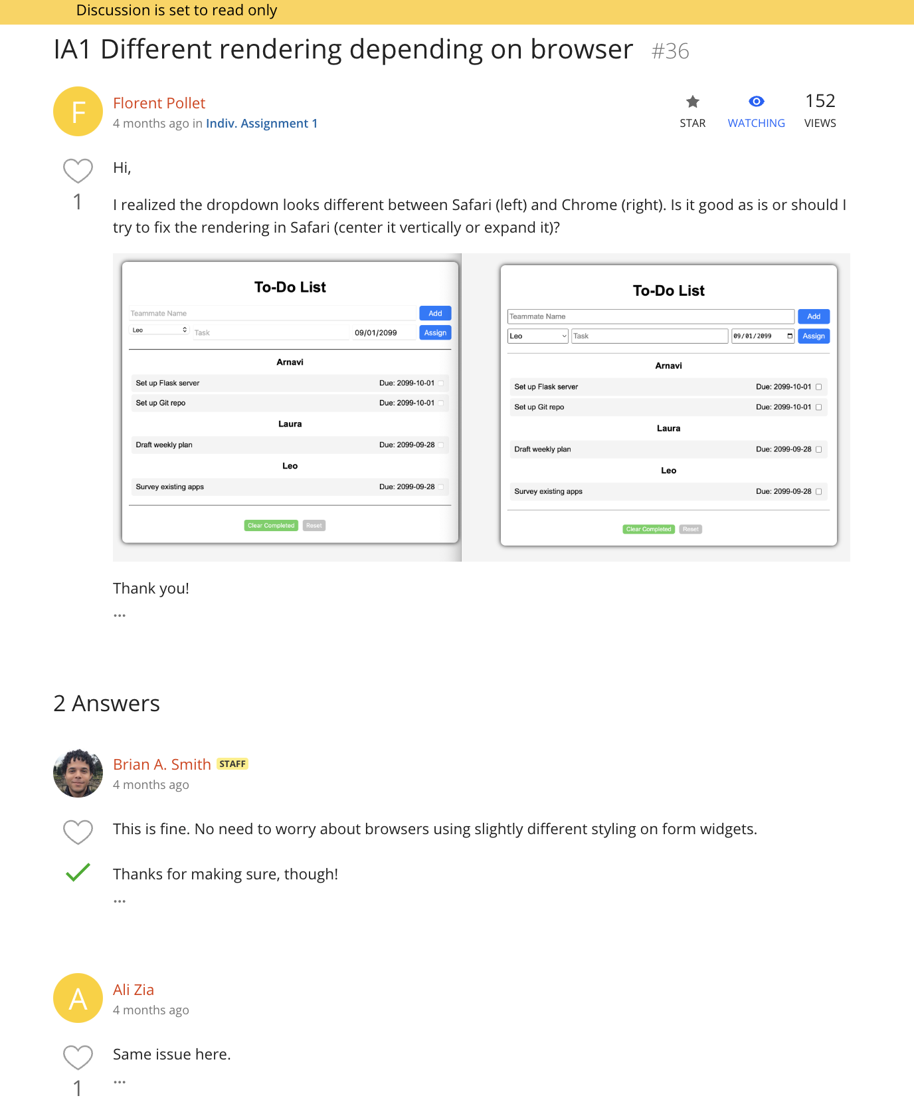

Slide 5
Course Logistics
Lectures Tue/Thu, 9-10:15
Recitations Mondays 9-10am (starting next week)
There will be 3 assignments, a Paper / Paper Discussion, and a Final Exam
Platforms:
Courseworks
Ed / Slack / canvas / harmonize / piazza (poll?)
Question: Flipped classroom?

Slide 6
Goals & Expectations
It is not my goal with this course to give you the most direct path to practical readiness.

Slide 7
Goals & Expectations
It is not my goal with this course to give you the most direct path to practical readiness.
This is because that path changes rapidly as technology changes, and intuition/understanding will serve you better in the long term.

Slide 8
Goals & Expectations
My goal is to give you sufficient mathematical and computational understanding to have an effective intuition and a health epistemic uncertainty about topics in ML/AI.

Slide 9
Goals & Expectations
My goal is to give you sufficient mathematical and computational understanding to have an effective intuition and a health epistemic uncertainty about topics in ML/AI.
And secondarily, to have you appreciate why ML/AI for health/biomedicine is different than other areas of ML/AI.

Slide 10
Goals & Expectations
It is my expectation that you will learn independently, outside of class.

Slide 11
Goals & Expectations
It is my expectation that you will learn independently, outside of class.
This is because (a) we have too much background material to cover and (b) ChatGPT & other tools have lowered the barrier to independent learning.

Slide 12
Goals & Expectations
I will be presenting my views on this field, not necessarily the field consensus.

Slide 13
Goals & Expectations
I will be presenting my views on this field, not necessarily the field consensus.
This is because I’m teaching the course so I get to.

Slide 14
Goals & Expectations
It is my intent to be organized and proactive with this course.

Slide 15
Goals & Expectations
It is my intent to be organized and proactive with this course.

Slide 16
Goals & Expectations
I will treat all of you as though you are here to learn in good faith, and ask that you assume that I and the teaching staff are here to teach in good faith.

Slide 17
Goals & Expectations
Columbia policies trump anything I or others in the teaching staff say at any time.

Slide 18
Approximate Syllabus
Through February: Math background refresh.
Through spring break: ML Fundamentals refresh.
After spring break: ML for health specifically.

Slide 19
Approximate Syllabus
Through February: Math background refresh.
Linear algebra, probability, calculus
Through spring break: ML Fundamentals refresh.
Optimization, ML evaluation, training, development, data types, losses, models, and algorithms
After spring break: ML for health specifically.
Health data differences, health model differences, health deployments.

Slide 20
Assignments & exams
Likely 3 assignments, colab notebooks including coding and mathematical (latex) components.
A team paper on a deep dive of an ML topic (e.g., model type) and its current usage, followed by a discussion / oral exam on that paper.
A final exam.

Slide 21
Activity: Epistemic Humility a.k.a. be confidently uncertain, be happy to be wrong
Ice cream sales
?
Fact: What’s the shape?
Argument: Why that shape?
Plausibility: Why that argument?
Drowning

Slide 22
Activity! Initial assessment
11 concepts / questions, 90 seconds per concept, one page per concept.
“Concept” will actually be set of related concepts
For each concept / question, attempt to (NOT IN ORDER):
Define the concept (formally, mathematically, operationally)
Describe the concept (qualitatively, with examples) and its key properties / related concepts.
Draw the concept (with a simple cartoon)
Not graded, not expecting you to finish everything. The goal of this is to calibrate the teaching staff on what you know.

Slide 23
Vector / Vector Space / Linear Operator / Matrix?

Slide 24
Random variable / PDF / PMF / Expectation?

Slide 25
Joint / Conditional / Marginal Random variable?

Slide 26
Information content, Entropy, Mutual information?

Slide 27
Gradient?
Also draw the gradient on this function at the indicated points

Slide 28
Stationary point, inflection point, local vs. global minima vs maxima, saddle point?

Slide 29
Gradient descent / stochastic gradient descent?

Slide 30
Latent variable, expectation maximization?

Slide 31
Binary classification, confusion matrix, AUROC?

Slide 32
k-nn, logistic regression, decision tree, ensemble method, neural network

Slide 33
Data types: Tabular data, regular grid data, ordinal sequences, time series, temporal point process/event stream. Also highlight models useful for these data types.

